Slide 1


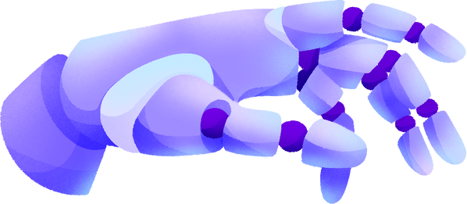
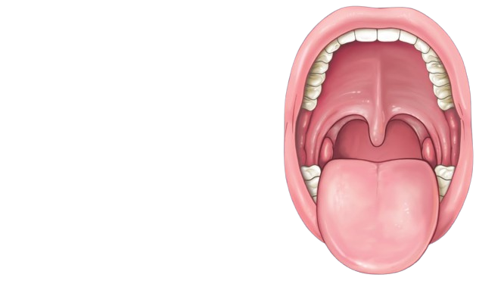

DEEP LEARNING BASED
ORAL CANCER DETECTION

Slide 2

ABTSRACT
Oral cancer is a prevalent and potentially life-threatening disease, emphasizing the critical need for early detection to improve patient outcomes.
This study explores the application of Recurrent Neural Networks (RNN) for the automated detection of oral cancer in medical imaging.
RNN, a deep learning architecture known for its efficacy in object detection, is employed to identify and localize abnormal lesions within oral images.

Slide 3


ORAL CANCER
INTRODUCTION
Oral cancer refers to the uncontrolled growth of abnormal cells in the oral cavity, which includes the lips, tongue, cheeks, floor of the mouth, hard and soft palate, sinuses, and throat.
The majority of oral cancers are squamous cell carcinomas, which develop from the flat, thin cells lining the oral cavity and throat.

Slide 4

ORAL CANCER RISK
INTRODUCTION
Tobacco Use: Smoking and smokeless tobacco use significantly increase the risk.
Alcohol Consumption: Heavy and prolonged alcohol use is a risk factor, particularly when combined with tobacco use.
Human Papillomavirus (HPV): Certain strains of HPV are associated with an increased risk of oral cancers.
Poor Oral Hygiene: Chronic irritation of the oral cavity, often due to poor dental hygiene, can contribute.

Slide 5

EXISTING SYSTEM
The project will investigate application of Transform Techniques to deep learning model Convolutional Neural Network (CNN), to analy ze their effectiveness in detecting oral cancer.
Additionally, the study compare and contrast the results of different optimization techniques to determine the most efficient way to optimize a deep learning model for oral cancer detection
Deep learning demonstrated significant potential in the field of medical image analysis

Slide 6




DISADVANTAGES
Computational Intensity:
CNNs, especially deep architectures, can be computationally intensive and require substantial processing power for training and inference.
01
Large Data Requirements:
CNNs typically require large amounts of labeled training data to generalize well to diverse inputs.
02

Slide 7

DISADVANTAGES
Overfitting:
CNNs are prone to overfitting, especially when dealing with limited training data. Overfitting occurs when a model learns the training data too well and performs poorly on new, unseen data.
03
Biases in Training Data:
CNNs can inherit biases present in the training data, leading to biased predictions. If the training data is not representative or contains inherent biases, the model may produce unfair or discriminatory outcomes.
04

Slide 8



PROPOSED SYSTEM

Slide 9

PROPOSED SYSTEM
The research utilizes a curated dataset comprising diverse oral pathology images, ensuring the model's robustness and generalizability.
The RNN model is trained to recognize subtle patterns indicative of oral cancer, enabling precise identification even in the early stages of the disease.
The integration of explainable AI techniques enhances the interpretability of the model's decisions, fostering trust among healthcare professionals.

Slide 10
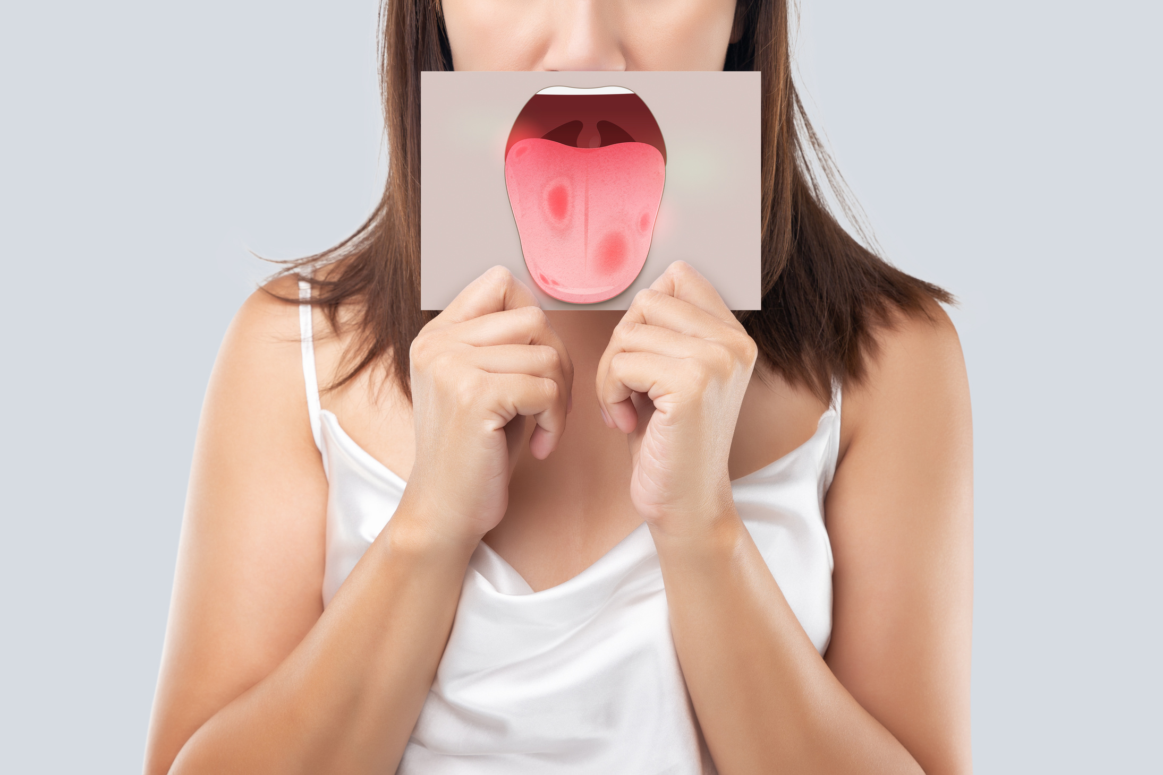
PROPOSED SYSTEM
Performance evaluation metrics such as sensitivity, specificity, and area under the curve (AUC) demonstrate the effectiveness of the proposed RNN approach in comparison to traditional diagnostic methods.
Real-world case studies illustrate the practical implications of deploying this technology, showcasing its potential to revolutionize oral cancer diagnostics.

Slide 11
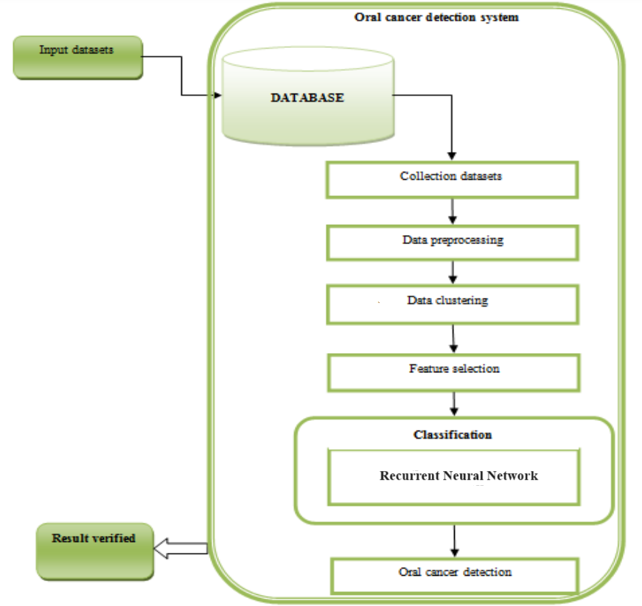
ARCHITECTURE

Slide 12





MODULES
MODULE 1
MODULE 2
MODULE 3
MODULE 4
Daatset Collection:
Collect oral cancer created using different techniques, including face swapping, and different scans. This ensures the model is exposed to a variety of data augmentation methods.
Data Preprocessing:
Emphasis on the significance of high-quality training data, and the role of data preprocessing techniques to ensure the RCNN model is trained on a diverse and representative dataset.
Training the RCNN Model: Insights into the process of splitting data into training and validation sets, along with the training process, optimization strategies, and fine-tuning specific to RCNN networks.
Evaluation Metrics: Introduction to key evaluation metrics, such as accuracy, precision, recall, and F1 score, tailored for assessing the efficacy of RCNN-based Oral Cancer detection.

Slide 13
HARDWARE/SOFTWARE REQUIREMENT
HARDWARE REQUIREMENTS:
System : Pentium i3 Processor.
Hard Disk : 500 GB.
Monitor : 15’’ LED
Input Devices : Keyboard, Mouse
Ram : 4 GB
SOFTWARE REQUIREMENTS:
Operating system : Windows 10 Pro.
Coding Language : Python 3.10.9, HTML, CSS,JS
Web Framework : Flask

Slide 14









ADVANTAGES
FLEXIBILITY WITH ARCHITECTURES
RNNs provide flexibility in terms of architecture. Different variants, such as Fast R-CNN and Faster R-CNN, offer improvements in terms of speed and efficiency while maintaining high accuracy.
STATE-OF-THE-ART PERFORMANCE
RNNs and their successors, such as Faster R-CNN and Mask R-CNN, have consistently delivered state-of-the-art performance on benchmark datasets for object detection and instance segmentation tasks.
ENHANCED ACCURACY
RNNs are inherently robust to noise and occlusions in the data. In real-world scenarios, videos may contain noise or occluded faces, and LSTMs can learn to distinguish between genuine variations and manipulated content.

Slide 15

CONCLUSION
As we delve into the future, this research not only underscores the promising advancements in oral cancer detection through RNN but also acknowledges the challenges and ethical considerations associated with implementing artificial intelligence in the medical domain.
The findings presented in this study contribute to the ongoing dialogue on leveraging deep learning for early and accurate oral cancer diagnosis, paving the way for improved patient care and outcomes.

Slide 16
REFERENCE
[1] Lin, Huiping, et al. ”Automatic detection of oral cancer in smartphone- based images using deep learning for early diagnosis.” Journal of Biomedical Optics 26.8 (2021): 086007-086007.
[2] Alabi, Rasheed Omobolaji, et al. ”Deep machine learning for oral cancer: from precise diagnosis to precision medicine.” Frontiers in Oral Health 2 (2022): 97.
[3] Welikala, R.A., Remagnino, P., Lim, J.H., Chan, C.S., Rajendran, S., Kallarakkal, T.G., Zain, R.B., Jayasinghe, R.D., Rimal, J., Kerr, A.R. and Amtha, R., 2020. ”Automated detection and classification of oral lesions using deep learning for early detection of oral cancer”. IEEE Access, 8, pp.132677-132693.
[4] Nanditha, B. R., A. Geetha, H. S. Chandrashekar, M. S. Dinesh, and S. Murali. ”An ensemble deep neural network approach for oral cancer screening.” (2021): 121-134.
[5] Ariji, Y., Kise, Y., Fukuda, M., Kuwada, C., Ariji, E. (2022). Seg?mentation of metastatic cervical lymph nodes from CT images of oral cancers using deep-learning technology. Dentomaxillofacial Radiology, 51(4), 20210515.

Slide 17








RESOURCES

Slide 18
THANK YOU!

